Slide 1
Project Report
Project title: Hand Gesture based mouse control
Name: Yukun Duan and Jianlin Dou
Description of project:
You can assess the mouse with gestures without physically touching the mouse. This project aims to detect the hand and count the fingers.
With one finger moving horizontally in front of the camera(phone), you can move the mouse, when moving vertically you can left-click.
With two fingers detected moving horizontally, you can scroll the mouse wheel, when moving vertically you can right-click.

Slide 2
Framework
Data:
Two phones will be set above and front and will record a hand-moving video (about 3 sec) at the same time.
Video recorded from different directions will be saved separately.
Algorithms/methods explored:
Motion Detection, Motion History Image, Normal Flow, KLT feature tracking
What we did (per team member):
1) Background Removal:
-Split each frame and show abs image differencing between consecutive frames.
2) Finger number detection:
-Check the angle between the farthest points and the concavities of the hand is within specified limits (usually the angle between the tip of our finger and the two closest concavities is within a certain range).
3) Horizontal movement detection:
-Using MHI detect the path and the motion of finger(s).
4) Vertical movement detection:
-Using normal optical flow detect the vertical movement of each consecutive frame. When movement on negative y-axis exceeds a certain threshold, it will report a click event.

Slide 3

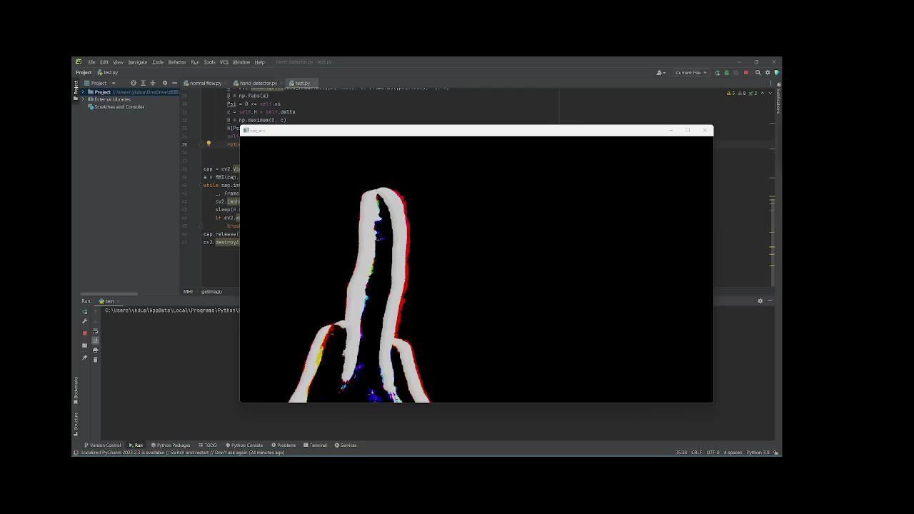


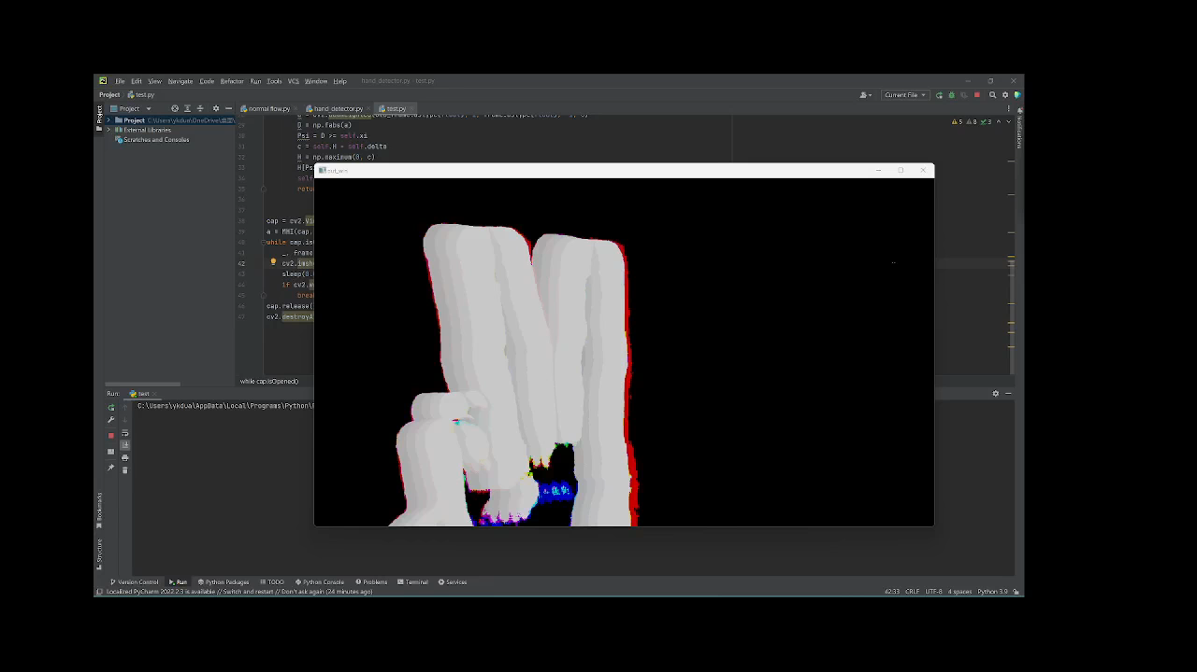

Results:
Finger detection Horizontal motion detection Vertical motion detection
Problems encountered &Next-step:
Problems: Self-made KLT tracking on feature points(Base on Harris detection) drift severely, didn't meet our expected. Strict data collection environment.
Next step: Bounding Mouse to actually control it. Generate fingertip coordinates to tell mouse the next location. Refine normal flow movement detection algorithms to better reduce hand shaking effects.

